Slide 1
Opening Indian Restaurant in Austin
By Raghuram Moturi
December 2020

Slide 2
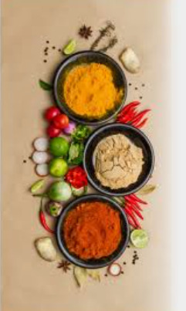
Business Problem
Austin is the capital of Texas in the United States and is one of the fastest growing cities in America.
Opening new Indian restaurant in Austin, TX may be profitable for restaurant owner. Our problem is Where to open Indian restaurant in Austin?

Slide 3
Data Sources
I gathered neighborhood data from the Housing and Planning Department of the Austin City Government
I got the demographic data information like population, race and ethnicity, and housing and density, grouped by neighborhood areas in Austin from Austin City Government
I used python geocoder library to get geographical coordinates of neighborhoods
I used Foursquare API venues explore method to get the venues of given neighborhoods of Austin.

Slide 4
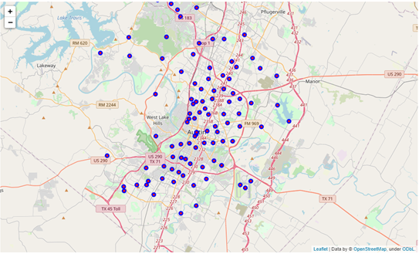
Methodology
I used python folium library to visualize geographic details of Austin neighborhoods and I created a map of Austin. I used latitude and longitude values to get the visual as below:

Slide 5
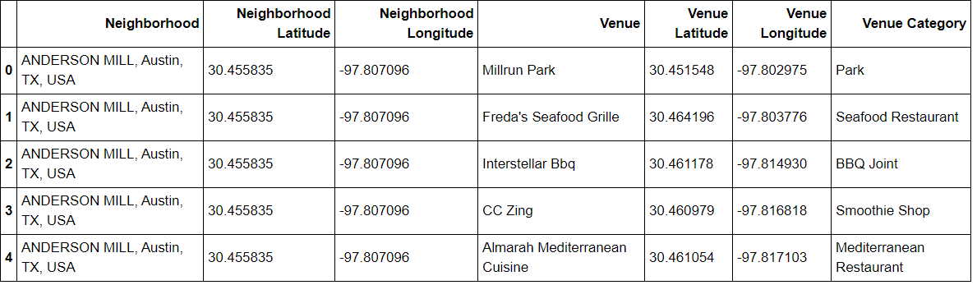
Methodology
I have requested the data from Foursquare API and collect information for the top 100 venues in the neighborhoods within a radius of 1500 meters
Here is the list of Neighborhoods along Venue details including latitude , longitude and Venue Categories

Slide 6
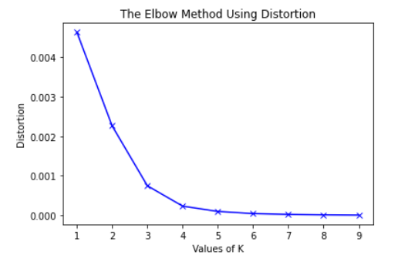
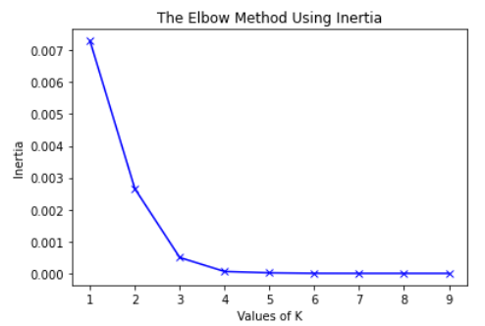
Methodology - Clustering
I used k-means clustering to cluster neighborhoods.
The Elbow Method was used to determine this optimal value of k. I iterated the values of k from 1 to 10 and calculated the distortion and inertia values for each value of k in the given range

Slide 7
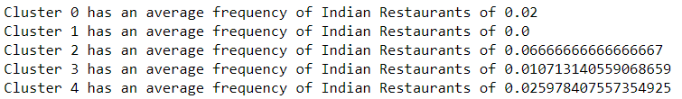
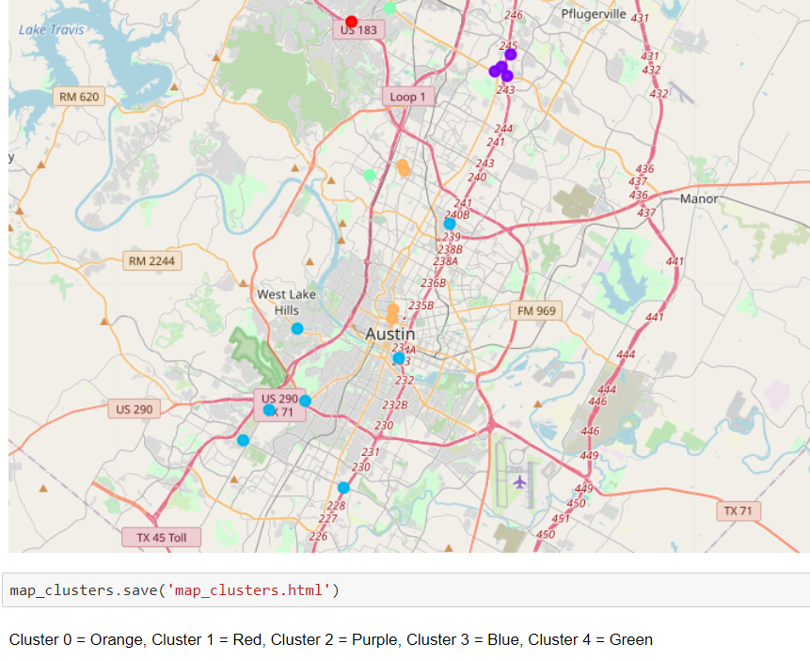
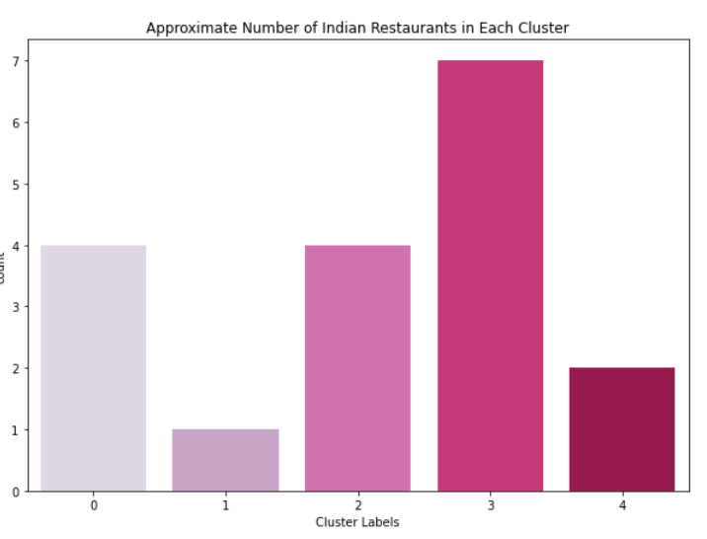
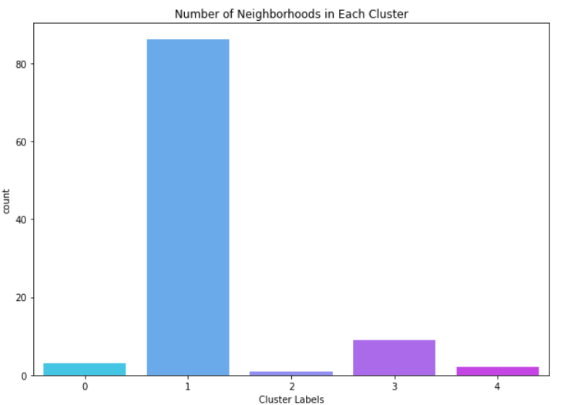
Methodology - Clustering

Slide 8
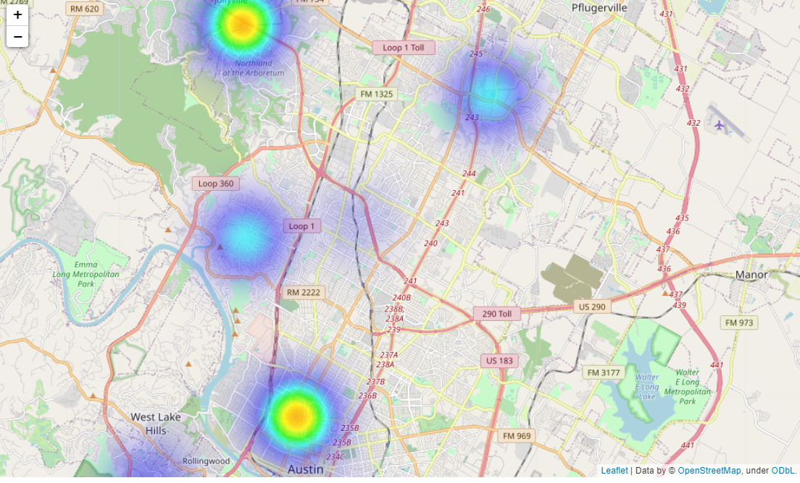
Results
As we see in the map, most Indian restaurants are located in Clusters 0,2 and 3, which are include neighborhoods in the northern and southern parts of Austin. Some of the neighborhoods in Cluster 3 (blue) are in South Metropolitan area but Cluster 3 has the second lowest frequency of Indian restaurants. Overall, Indian restaurants are concentrated in north and south Austin. This is interesting information so far!

Slide 9
Discussions
I found that Cluster 0 has the lowest average frequency of Indian restaurants while Cluster 2 has the highest.
Cluster 1 has the highest number of Indian restaurants, with a lower average frequency
Based on the demographic data I found, the top 9 neighborhoods with the highest Asian population density don't have a high frequency of Indian restaurants. These neighborhoods include UT, Lake Line, Gateway, West University, and Anderson Mill and so on.It makes sense since some of these neighborhoods have a very small total population. However, highly populated college neighborhoods like UT, West University with many Indian students don't have a high frequency of Indian restaurants.
Some neighborhoods are much larger but less populated while others are more densely populated with a smaller area. Thus, the Foursquare API might not have been able to capture all the Indian restaurants in each neighborhood. However, we calculated the frequency of Indian restaurants within the 1500 meter radius, which could still reflect the average frequency of Indian restaurants within that neighborhood.

Slide 10
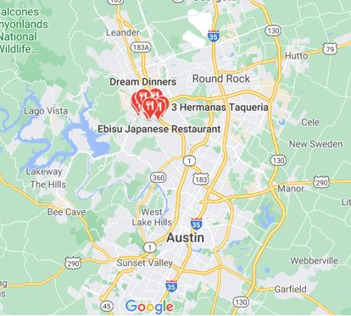
Conclusion
I collected the neighborhood zoning information from Austin City government and used Google Geocoding API to find the approximate coordinates for those neighborhoods. We then used Foursquare API to discover the 100 venues within the radius of 1500 meters in each neighborhood and took the average frequency of Indian restaurants in comparison to other venues. Using clustering algorithm, we grouped the neighborhoods in a total of 5 clusters, with Cluster 0 having the lowest average frequency of Indian restaurants. Finally, we compared the clusters to the neighborhood demographic data provided by the government and found that the neighborhoods with the highest percentages of Asian population don't have a very high frequency of Indian restaurants.
Then I concluded that Anderson Mill is the best neighborhood to open an Indian restaurant based on our cluster analysis and the demographic data.

Slide 11
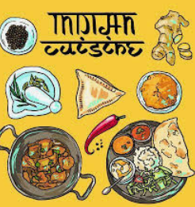
Thank You…

